Slide 1
Work report
2021/03/04

Slide 2
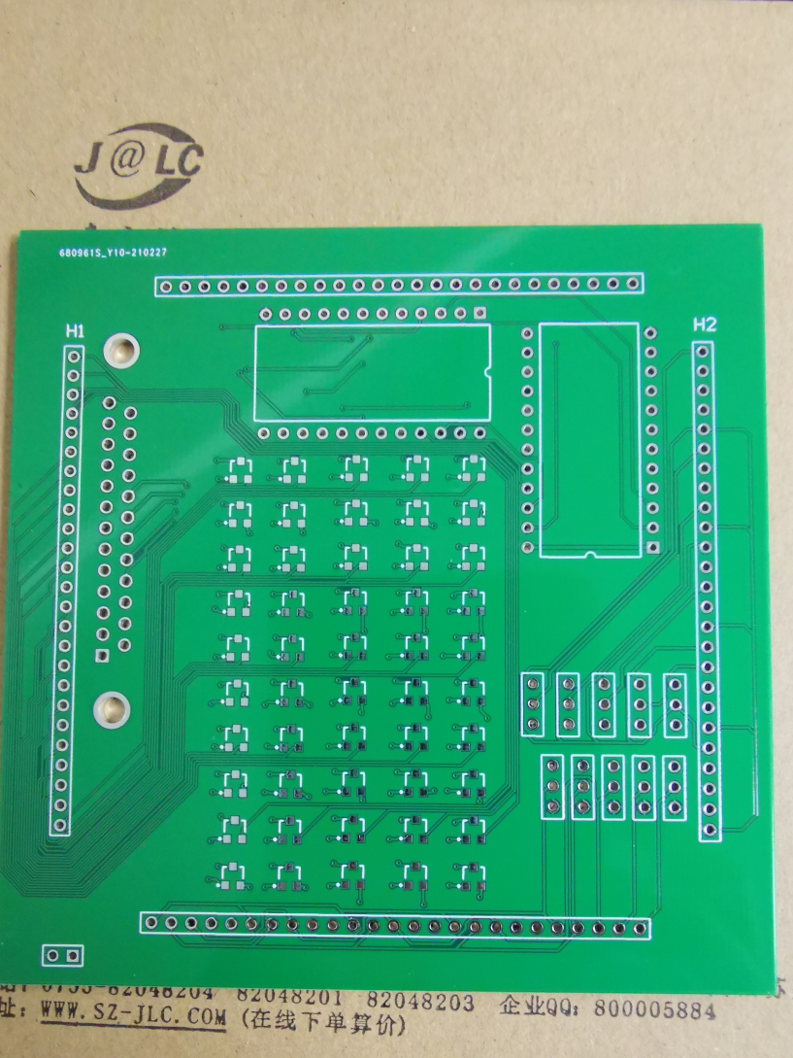
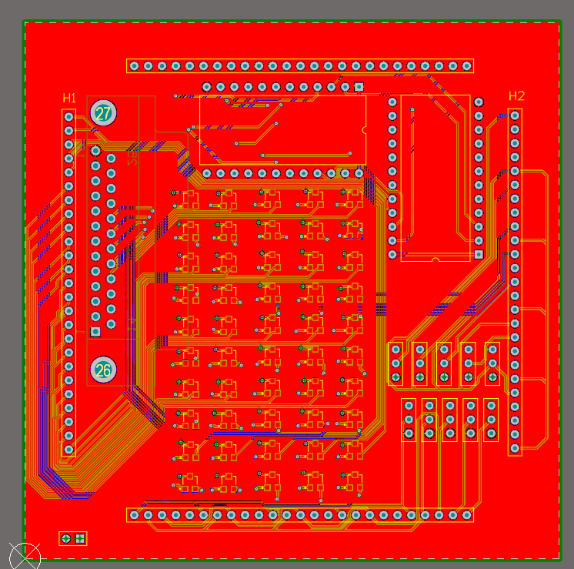
Hardware
Decode chip
Triode array
Variable resistor

Slide 3
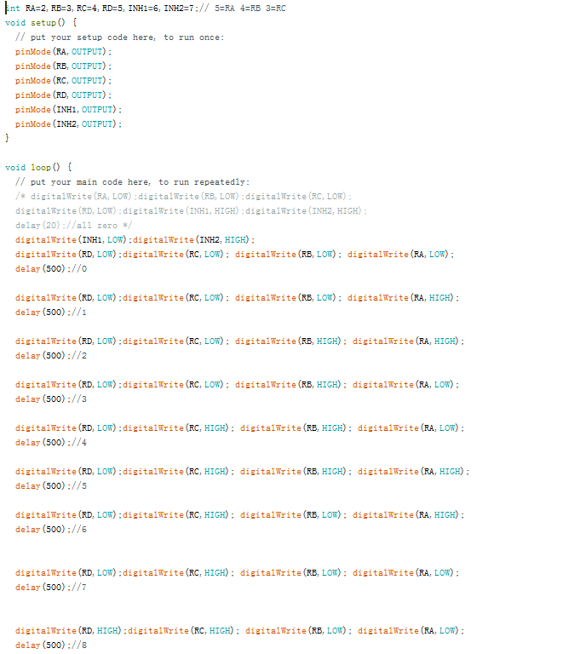
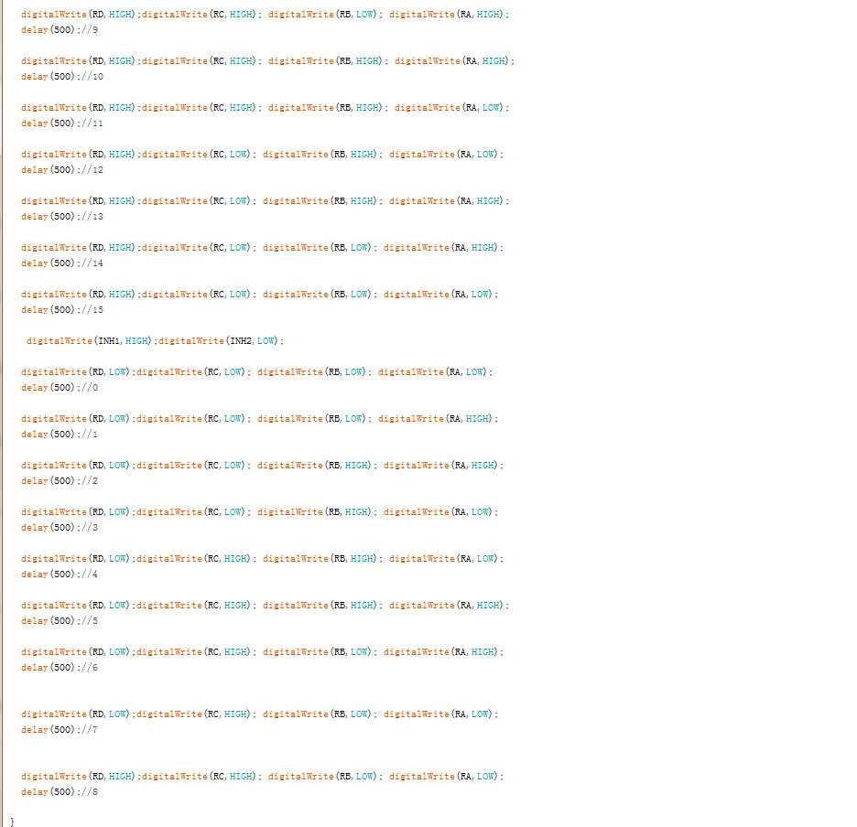
Software of scan signal

Slide 4
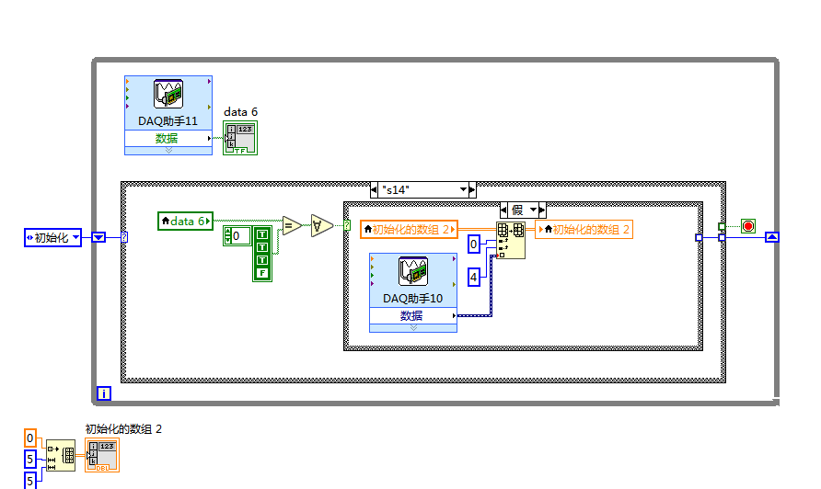
software of reading data

Slide 5
Future plan
PCB assembly
Cooperate with software for testing

